Slide 1
Interviews and news
28 Reported speech, questions

Slide 2

Current news
Do you read or watch the news?
What is the most recent news you heard or read?
What has been the most shocking news you have heard or read?

Slide 3
Reported speech, Yes / No questions
When we report a Yes / No question that someone has asked, we add the words if or whether.
Since the reported question becomes a statement, it does not require a question mark.
In reported Yes / No questions, the subject always comes before the verb.
“Is there a bank on this street?”
He asked (me) if there was a bank on that street.
“Are you buying a car?”
She asked if I was buying a car.
“Do they go to the bank every week?”
She asked whether they went to the bank every week.

Slide 4

Report the questions
1. “Did Steve give you these links?” Sara asked Joe.
Sara asked Joe if ____________________.
2. The tourist wanted to know, “Is this a common situation in your country?”
The tourist asked if ____________________.
3. “Do I have the correct information?” Peter wondered.
Peter wondered whether ____________________.
4. “Is the economy worsening?” he asked.
He asked if ____________________.
5. “Are Sally and Kate reading the newspaper?” Reese wanted to know.
Reese wanted to know if ____________________.
6. “Has your mother turned on the news yet?” Zack asked his girlfriend.
Zack asked his girlfriend whether ____________________.
7. Ben asked Penny, “Are you aware of the consequences this is going to have?”
Ben asked Penny if ____________________.
8. “Were they alive or not?” I wondered.
I wondered whether ____________________.
Notes:
1. Sara asked Joe if Steve had given him those links.
2. The tourist asked if that was a common situation in the country.
3. Peter wondered whether he had correct information with him or not.
4. He asked if the economy was worsening.
5. Reese wanted to know if Sally and Kate were reading the newspaper.
6. Zack asked his girlfriend whether her mother had turned on the news yet.
7. Ben asked Penny if she was aware of the consequences that was going to have.
8. I wondered whether they had been live or not.

Slide 5
Reported speech, WH questions
She asked him, “Where did you go last night?” (direct speech, past simple)
She asked him where he had gone the night before. (reported speech, past perfect)
When a Wh- question is reported, the word order follows the rules for sentences: question marks and
quotation marks are deleted. We keep the Wh- word.
There are three changes in reported speech for Wh- questions:
the verb tense and word order change
the pronoun changes
the time expression changes
In questions about the subject, there is no change in the word order.
“Who is going to the party?” he asked.
He asked who was going to the party.
Common verbs used in reported questions are: ask, inquire, wonder, would like to know, want to know

Slide 6
Report the questions
“Who was the reporter last month?” he asked.
“When does the president finish his period?” Sue wanted to know.
“Why don’t you read the news on Twitter?” Kate asked her brother.
The man inquired, “How much have you and your husband spent on entertainment so far this month?”
“Where is the link for the podcast?” we inquired.
“Which media did you prefer?” the survey asked them.
“How does she know about the latest news?” they wanted to know.
Jenny wondered, “What information do I need to write down?”
Notes:
1. He asked who had been the reporter the previous month / the month before.
2. Sue wanted to know when the president finished his period.
3. Kate asked her brother why he didn’t read the news on Twitter.
4. The man inquired how much me and my husband / my husband and I / we had spent on
entertainment so far that month.
5. We inquired where the link for the podcast was.
6. The survey asked them which media they had preferred.
7. They wanted to know how she knew about the latest news.
8. Jenny wondered what information she needed to write down.

Slide 7
Choose the correct reporting words or question words
The reporter asked / wondered me how much time I spent watching tv.
He wanted to know where / who was my favorite newscaster.
I would like to know / said what the article was about.
The woman asked him how many / where he got his information.
Tim wanted to know when / which you were available for a live interview.
She told / wondered what question she was going to be asked.
Jim asked his dad how much / how many fake articles he had already read that month.
They wanted to know / complained who wrote the fake news.
Notes:
1. Asked
2. who
3. know
4. Where
5. When
6. Wondered
7. how many
8. wanted to know

Slide 8
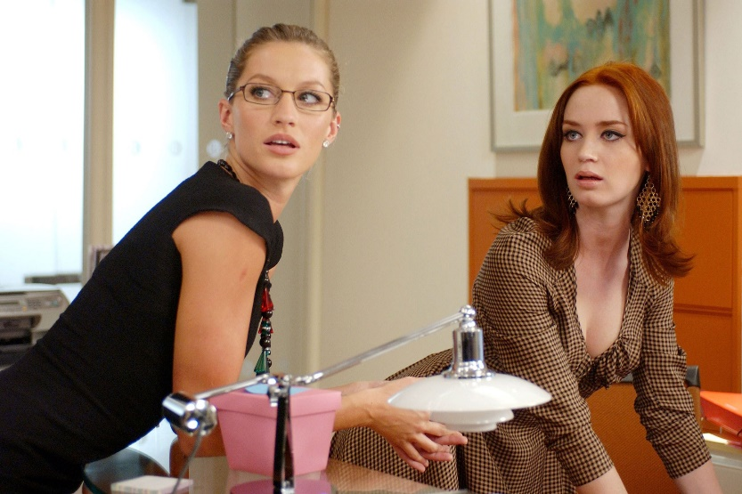
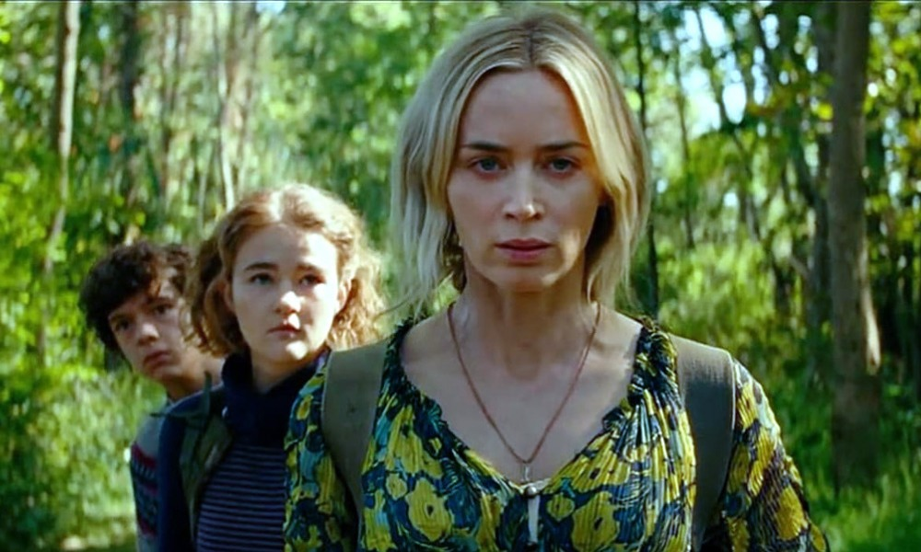
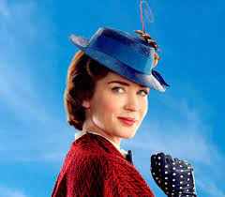
Emily Blunt’s Vogue Questions
Check Emily Blunt’s Vogue video up to second 0:56
Report all the questions you hear.
Notes:
https://www.youtube.com/watch?v=eWHN7pBRzIo
Do you like living in NY city? He asked her if she liked living in NY city
Where did you grow up? He asked her where she had grown up.
What do you miss most about England when in America? He asked her what did she miss most about England.
What do you miss most about America when in England? He asked her what did she miss most about America.
Is there anything NY had over London? He asked her if there was anything NY had over London.
What is the best part about being on set? He asked her what was the best part about being on set?
Would you ever consider writing? He asked her if she would ever consider writing.
What about directing? He asked her if she would ever consider directing.
Who is a director you would love to work with but you haven’t had the chance yet? He asked her who was a director she would love to work with, but had not had the chance yet.

